Slide 1

The Brain
Backend Reasoning & Analysis Intelligence NetworkA Sovereign Agentic Intelligence Engine for NGUK
STRATEGIC BRIEFING · 2025

Slide 2


The Strategic Imperative
SDR25 Mandate
£1.2B Market
AI named the decisive discriminator of next-generation warfare. OODA loop acceleration: a national priority.
UK defence AI market by 2028 — 13.4% CAGR. Decision-support systems: 38% of total spend.
Readiness Gap
Commons Defence Committee, Jan 2025: MOD is 'not yet AI ready.' A strategic vulnerability, not a bureaucratic one.
China's PLA demonstrated LLM-enabled ISR advances throughout 2024 — decision support, cyber operations, and information campaigns. The window to act is narrow.

Slide 3

NGUK's Position — and the Internal Gap
Sovereign Strength
5,000+ personnel across 10+ UK sites
Proven data science, ML & secure cloud capability
Security pedigree no commercial vendor can match
Internal Inefficiencies — the Precondition
Intelligence workflows: manual and labour-intensive
Multi-domain data: siloed
ITAR / EAR / IATM compliance: error-prone manual processes
Resolving these is not peripheral — it is prerequisite to MOD performance.

Slide 4
The Core Objective
1
2
3
Eliminate Operational Delay
Accelerate Decision Cycles
Generate Sovereign IP
Meet and exceed OODA loop performance required by MOD's Information Advantage mandate.
NGUK-owned, NGUK-controlled — licensable to Five Eyes, NATO allies, and UK agencies. £150M+ 5-year value.
Deploy agentic AI across intelligence triage and engineering compliance — removing manual, automatable work.

Slide 5

Competitive Landscape
The AI arms race in defence is accelerating. NGUK must move first in the UK sovereign space.
Organisation
Capability
NGUK Implication
Threat Level
Palantir AIP
LLM decision support, drone ISR, edge compute — 20–25% US market share
US-sovereign; incompatible with UK classified nets. NGUK can own this space domestically.
High
Scale AI Defense Llama
Fine-tuned Llama 3 on classified US mil-spec data — removes AI refusals for military queries
Direct functional blueprint. NGUK must build UK equivalent before Scale AI pivots to MOD.
Critical
Hadean (UK)
DASA-funded LLM for British Army virtual training — dynamic terrain simulation
Training-domain only. Validates UK appetite. NGUK should pursue parallel sovereign contract.
Medium
Sovereign Build vs. Licence: Licensing creates permanent vendor dependency. Palantir's DoD contract escalated 340% over three years. The financial crossover point is Month 14 — after which the sovereign path dominates on every metric. 3-year NPV advantage: £67.3M.

Slide 6
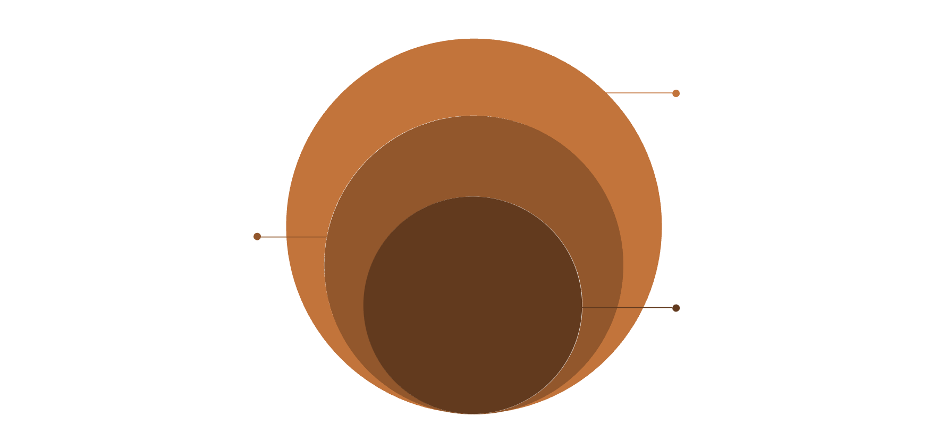
System Architecture
Five Integrated Layers
UI Layer
Structured decision dashboard — insights, risks, evidence, confidence scores.
RAG Data Layer
Orchestration
Vector DB and document repository
Decomposes queries into auditable reasoning steps.
Multi-Agent
Multi-Agent Workflow
Retrieval, analysis, risk, validation
Retrieval → Analysis → Risk → Validation (Critic Agent).
Core LLM
Air-gapped private model
LLM Core
Privately deployed — zero external API connectivity.
RAG Data Layer
Vector database grounding all outputs in verified source material.

Slide 7
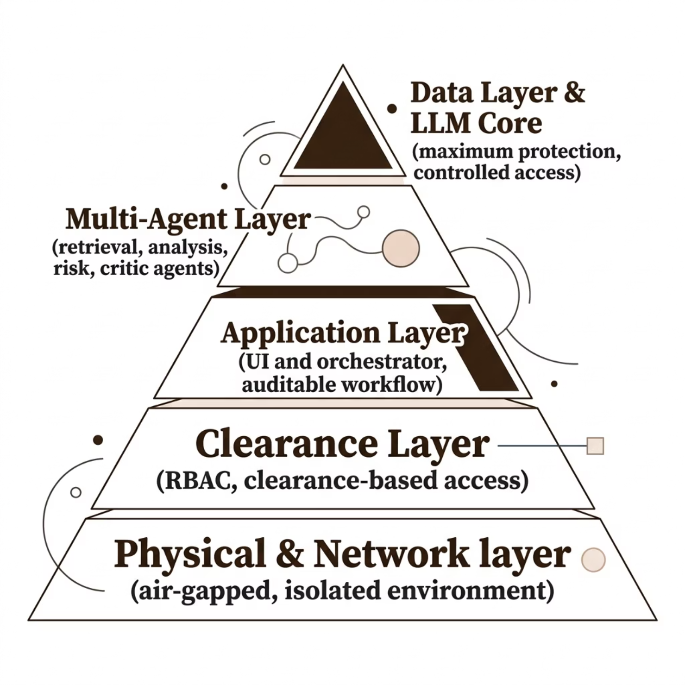

Security & Governance
HITL Governance
Confidence Thresholding
Decision Ledger
Immutable, timestamped audit trail — every inference, source, and reasoning step logged.
Outputs below 82% auto-escalate to human reviewer before release.
Clearance Partitioning
Red Team Schedule
RAG graph segmented: OFFICIAL → OFFICIAL-SENSITIVE → SECRET → TOP SECRET. Architecturally enforced.
Monthly adversarial testing — prompt injection, data poisoning, clearance boundary probing.

Slide 8





Ethical Framework
Human Oversight
Mandatory HITL architecture. Confidence indicators on every output. Decision support only — never autonomous.
Hallucination Control
RAG grounds all outputs in verified in-house data. Source-linked evidence — every claim traceable to original document.
Accountability
Automated Decision Ledger records full reasoning path. Aligns with MOD AI Ethics Principles (2022) and JSP 936.
Data Security
Air-gapped deployment. RBAC + clearance-based filtering. Encryption at rest and in transit. No third-party APIs.

Slide 9
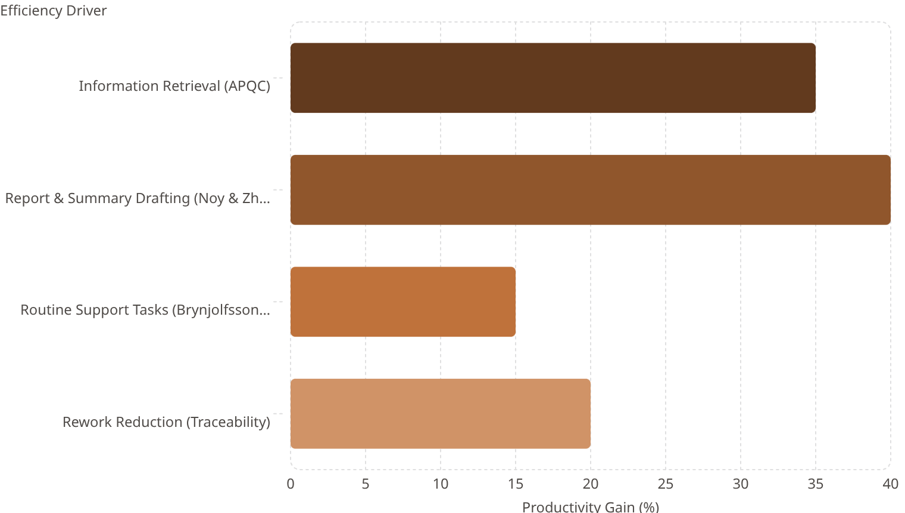

Return on Investment
Investment Context
35
Enterprise AI deployment benchmarks (Forrester, 2025):
40
£3–25M
116–416%
Typical 3-year deployment cost range
Reported ROI from commissioned case studies
15
20
Month 14
Sovereign build financial crossover vs. licensing
3-year NPV advantage of sovereign build over licensing: £67.3M

Slide 10





The 2030 Vision
From Defence Contractor to National Security Partner
Digital Targeting Web
Core orchestrator for SDR25's sensor-to-shooter mandate. IOC: April 2026.
Sovereign IP Platform
£150M+ licensing potential — Five Eyes, NATO, UK agencies. Revenue unavailable to any licensing-only path.
JSP 936 Benchmark
First major system designed for DAIC AI Model Arena. Trust-first, transparent, auditable.
Social Value
Sustains high-value data science roles across 10+ UK sites. PPN 002 and Procurement Act 2023 aligned.
The central discriminator is not the AI alone — it is Sovereign Control over data exhaust and model weights. Mandated by the 2025 Defence Industrial Strategy for Operational Independence in contested environments.

